Slide 1
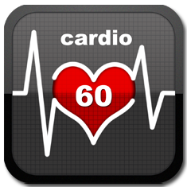

Mitigating Alarm Fatigue with
Precise.ly
Sameh Saleh
Notes:
Hi, my name is Sameh Saleh and I want to talk to you all about mitigating Alarm Fatigue in the hospital with a novel approach called Precise.ly.

Slide 2






Motivation
Notes:
As a current 4th year medical student at University of Virginia, I’ve seen the following situation happen repeatedly.
You’re a doctor or nurse in the INTENSIVE CARE UNIT and you hear new alarms for two different patients. You have to determine what each alarm is and if and how quickly you need to respond. Now, this all sounds reasonable until you put it in context.

Slide 3


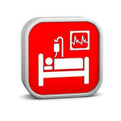
Defining the Problem
100s of alarms per patient/day
1,000s of alarms in ICU/day
10,000s of alarms in hospital/day
90 - 99% of alarms do NOT require clinical intervention.
Notes:
When you count all the alarms for all patients across a hospital you have on the order of 10,000s of alarms per day. That’s a lot. But what’s the real kicker is that 90-99% of these alarms do not require clinical intervention.

Slide 4
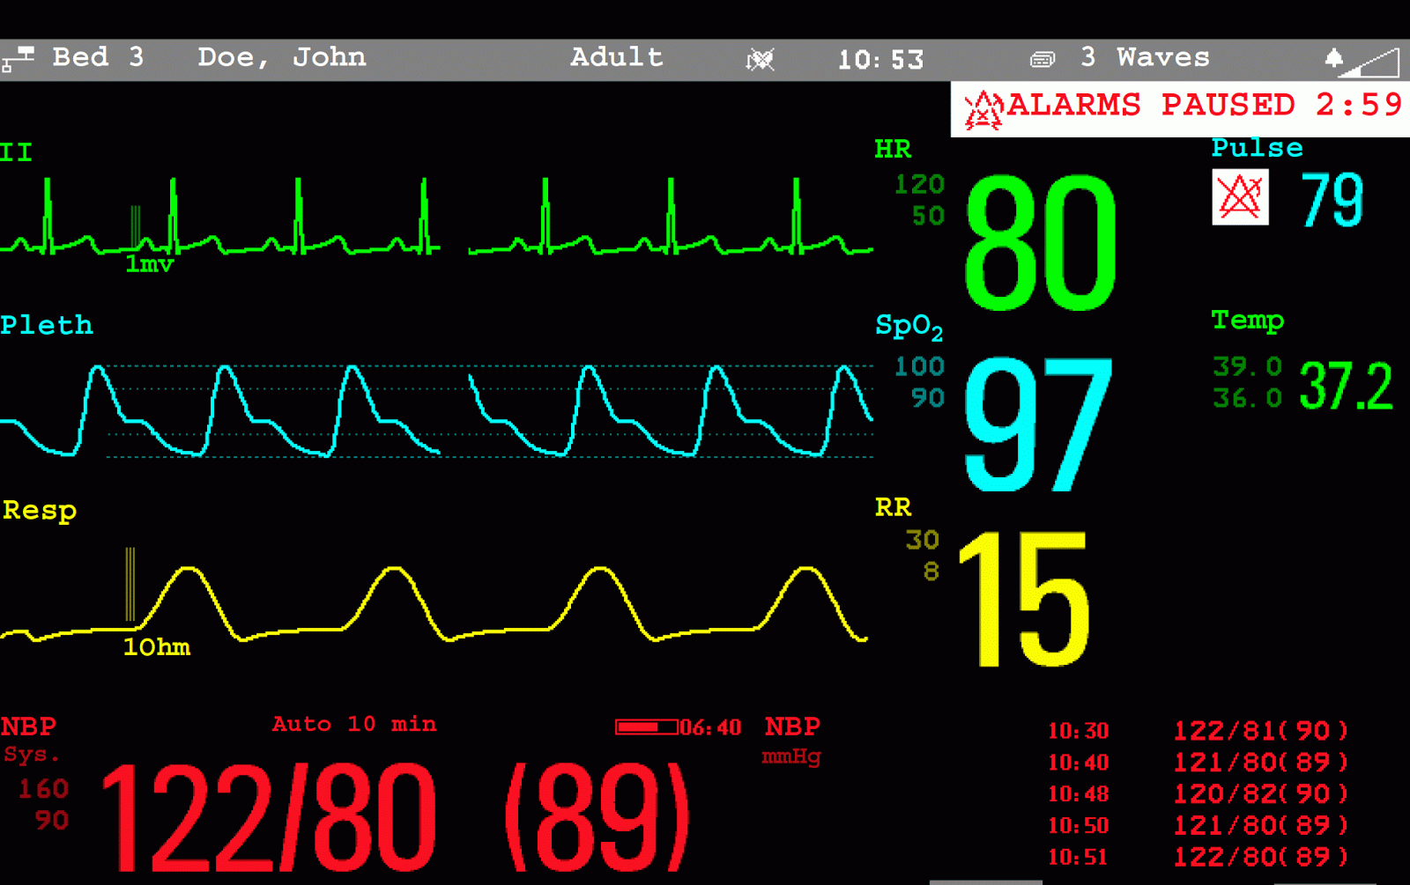
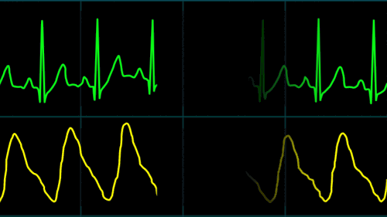
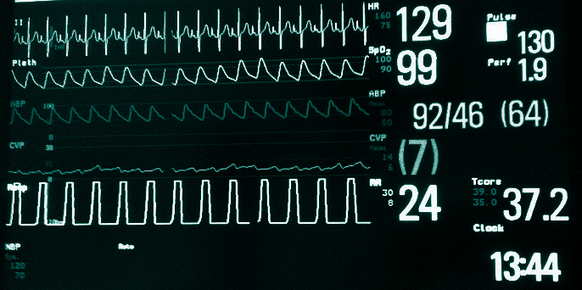
Let’s Talk About Heart Rate
Status quo:
All patient have same limits.
Notes:
Let’s hone in on heart rate. For this patient you can see their current HR is at 129 and their limits are at 50 and 120 so this should trigger an alarm for this patient, but what often happens is healthcare providers either ignore or mute the alarms.
The crux of the issue is that currently all patients have those same limits.

Slide 5
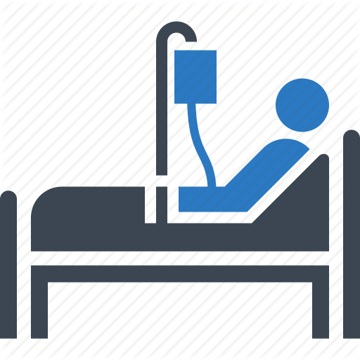


But…
Different patients
at different times
= different physiologic states
= different heart rate distributions
So...
Principle:
One size does NOT fit all.
Notes:
But different patients at different times have different physiologic states and therefore different heart rate distributions. One size does not fit all for those alarm thresholds.

Slide 6




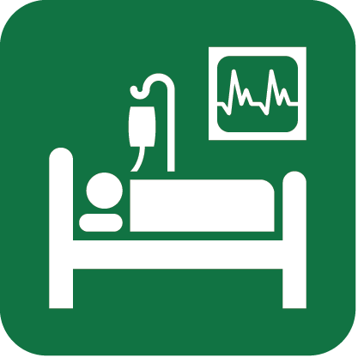

The Goals
1) Find groups of patients with similar HR distributions
2) Classify future patients in correct group
‘
Target:
Heart rate distributions
Features:
Demographics, Diagnoses, Location in Hospital, Medications
Notes:
Our endpoint is to develop a precision alarm thresholding system that links to your physiologic state. To do that 1) we want to find groups of patients with similar HR distributions that can be represented by one overall distribution and 2) Be able to classify future patients in the correct group
So to address this goal I used data gathered from UCSF in March 2013. The targets are the heart rate distributions and the features are the static demographics, diagnoses, and location in hosptial and the dynamic medications.

Slide 7
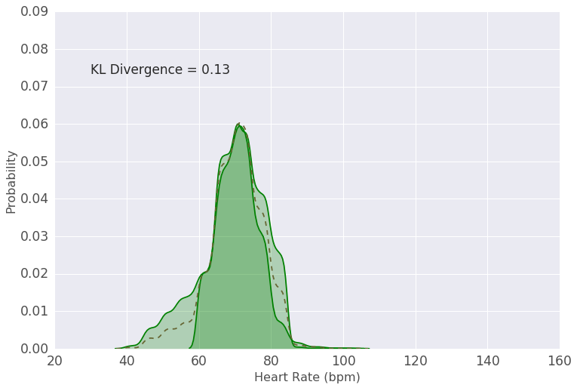
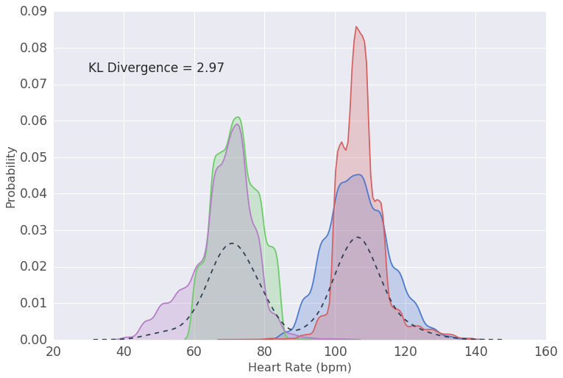
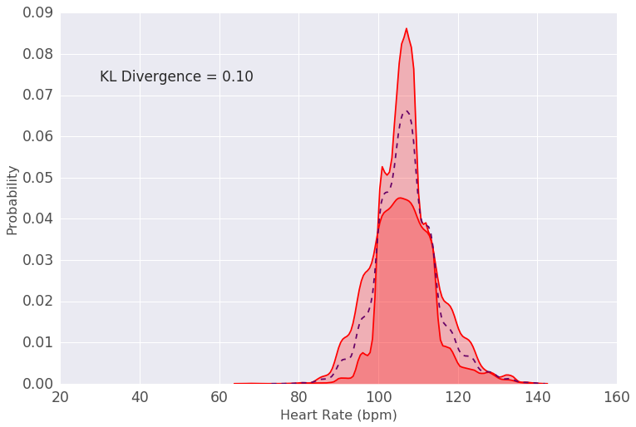
KL-Tree Learning
Sum of
Age < 38
Sum of
Sum of
Age > 38
Notes:
There was no obvious existing algorithm to address this problem so I created a new decision-tree-based algorithm for predicting distributions called KL-Tree Learning.
The example here is of one split in the tree.
On the left, each of the four colors is a different distribution. The average amongst these distributions, shown in black, poorly represents all four distributions. Using the KL divergence as a measure of distance between distributions, the algorithm uncovers that a split on the age of 38 separates the 4 distributions into two neat groups with representative average distributions.
This process is iterated to build the full tree where the leaves represents groups of patients with similar physiologic states. We applied this algorithm on our dataset and built full tree.

Slide 8
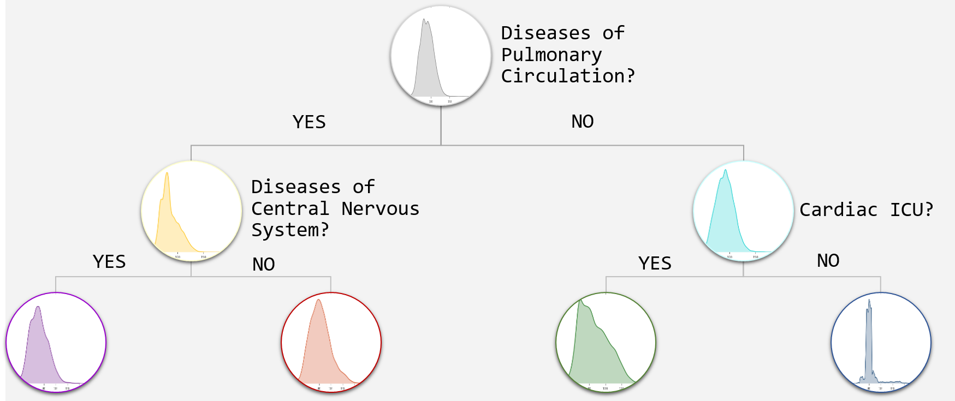
Tree of Distributions
Depth 3
Depth 4
Depth 5
Notes:
Let’s look at a part of the tree. We start with the gray distribution. We split on the best features – in this case the presence of disease of pulmonary circulation. We continue to split further and get four starkly distinct average heart rate distributions for four populations that were abstracted away higher up the tree. You can quickly see the power of KL tree learning for understanding different physiologic states. Let’s zoom in further into the tree and look at the split on cardiac ICU.

Slide 9
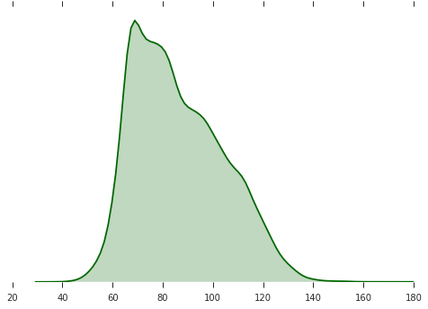
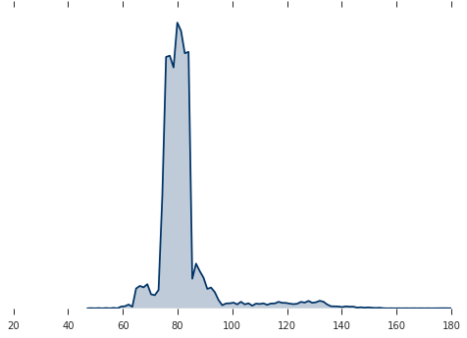
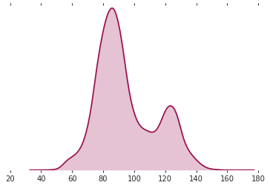
The Outcome
Heart Rate (bpm)
Heart Rate (bpm)
Heart Rate (bpm)
Age > 38
NO Resp Disease
Artery Disease
IN Cardiac ICU
Age > 38
NO Resp Disease
Artery Disease
Not IN Cardiac ICU
Age > 77
Atrial Fibrillation
Notes:
For the green and blue distributions we see being in the Cardiac ICU have much wider distributions indicating their clinical instability. Contrast that to another cluster with a condition called atrial fibrillation that has a starkly different bimodal distribution.
With Precise.ly, when a new patient comes into the ICU or a patient receives a new medication, their thresholds will be smartly adjusted based on those that were in similar physiologic states. Let’s look at a demo.

Slide 10
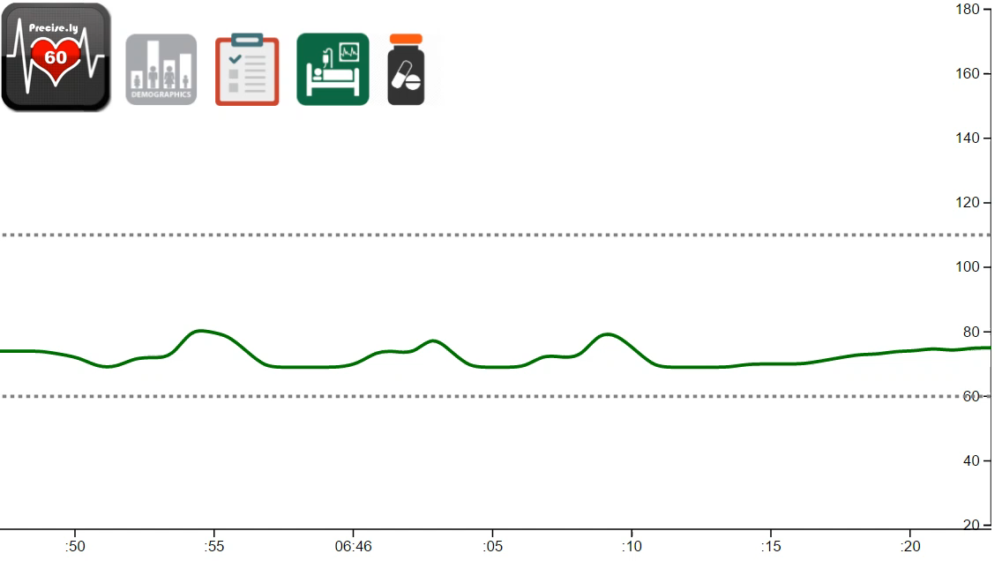
Precise.ly
Notes:
For this patient, their thresholds of 60 and 110 were set by their static demographics, diagnoses, and ICU location, but with the introduction of a new medication Propranolol which is expected to drop your heart rate, the thresholds shift down to 50 and 100 as their physiologic state has changed. Despite the shift, the alarm still goes off indicated a violation of the parameters of their new physiologic state.

Slide 11
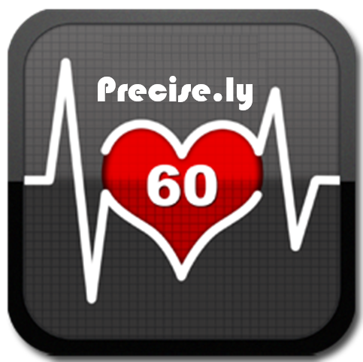
Next Steps: Precise.ly
Expand
- Quantity of Data
- Other Vital Signs
2) Implement
- Real-time
monitoring
Medical Center
Notes:
So we created the framework of a precision monitoring system that provides you heart rate alarms that actually matter. Now the next step is to expand with more data and to other vital signs and then, implement Precise.ly at UCSF medical center with real-time monitoring. Precise.ly addresses the crux of the problem of alarm fatigue and improves alarm safety.

Slide 12



Special Thanks:
Contact Information
sameh.n.saleh@gmail.com
- Instructors:
Brian
Ramesh
Andrew B.
- UCSF Physiologic Nursing
- Esteemed classmates
- Stack Overflow
/in/ssaleh2
/ssaleh2
Notes:
Thank you all for your time. If you’re interested, I would love to talk to you about it

